Slide 1
AI-Powered Threat Detection for Networks
ICT Capstone Project Presentation
Group: 1 Unit: COIT20265
Project Mentor: Dr. Fariza Sabrina Term: 2024 Term 3
Students: Jay Dilipbhai Yadav (BNE)
Sonam Pelden (BNE)
Harshkumar Dharmendrabhai Patel (BNE)
Akshitha Ishan Ranasinghe Walgama
Ranasinghe Arachchilage (BNE)

Slide 2
CONTENT HEADING
Introduction
Background Study
Aim and Objectives
Literature Review
Methodology
Dataset Description
Threat Detection Using AI
Methodology
Handling missing values
Pre-processed Data
Exploratory Data Analysis
Model Evaluation
Model Comparison
Web application functionalities
Conclusion
Recommendations
References

Slide 3
Introduction
AI-Powered Threat Detection
An advanced system leveraging machine learning models to identify, classify, and mitigate cyber threats in real time.
Detects vulnerabilities using natural language processing and network analysis, offering actionable insights for enhanced security.
Combines AI models with a user-friendly web application for seamless threat detection and response.

Slide 4
Background Study
Cloud as a Business Backbone: The cloud has transitioned from an emerging technology to an essential infrastructure for modern businesses, offering flexibility, scalability, and cost savings(Unlu, 2025).
Inherent Security Risks: Cloud environments are not inherently secure, with 45% of breaches being cloud-based, highlighting the vulnerabilities within multi-cloud setups(Unlu, 2025).
Shared Responsibility Model: Cloud security is a shared responsibility between the customer and the cloud provider, emphasizing the importance of robust security strategies(Unlu, 2025).

Slide 5
Background Study
Industry Challenges:
69% of organizations have reported data breaches or exposures caused by multi-cloud security misconfigurations(Unlu, 2025).
96% of organizations face challenges in implementing effective cloud strategies.
Cloud Security Incidents:
80% of companies reported experiencing cloud security incidents in 2023, with 27% of public cloud incidents, marking a significant rise from 10% the previous year.

Slide 6
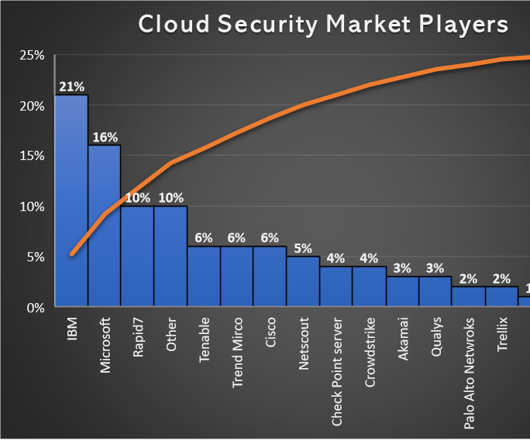
Background study
Cloud Adoption Trends:
76% of enterprises are adopting multi-cloud strategies(Unlu, 2025).
35% of industries host over 50% of their workloads in the cloud, with 29% planning further migration.
Market Statistics:
The cloud security market was valued at $20.54 billion in 2022, indicating its growing significance for businesses globally.
IBM dominates the market with a 21% share, reflecting its leadership in the cloud security industry (Figure.1).
Data Breaches: In the fourth quarter of 2023, more than 8 million records were exposed due to data breaches, underscoring the pressing need for robust cloud security measures.
Figure.1 Cloud Security Market Players

Slide 7
Aim and Objectives
The main aim of this project is to develop a real-time threat detection system for a company forum, ensuring secure communication by identifying and mitigating risks effectively.
Detect threats in real-time from employee posts on the company forum.
Notify the admin when a potential threat is identified.
Enable admin review and block users involved in malicious activities.
Permanently block users upon confirmed violations to ensure long-term security.
Maintain a safe and secure environment for employee communication.

Slide 8
Literature Review
Authors | Year | Title | Methodology | Findings | Limitations | Relation to Proposed System
Mallikarjunaradhya, V., Pothukuchi, A.S., and Kota, L.V. | 2023 | Overview of the strategic advantages of AI-Powered Threat intelligence in the cloud | Market dynamics and strategic analysis of AI's role in cloud security(Mallikarjunaradhya, Pothukuchi and Kota, 2023) | AI improves adaptive, predictive, and automated cloud security; highlights challenges for product managers | Lacks specific implementation examples; theoretical analysis | Provides a strategic foundation for integrating AI in threat detection, emphasizing automation and predictive analysis, aligning with the system's objective to proactively mitigate network vulnerabilities.
Wang, B.-X., Chen, J.-L., and Yu, C.-L. | 2022 | An AI-Powered Network Threat Detection System | Development of AI@NTDS system using feature evaluation and ML algorithms (LightGBM, Random Forest, K-NN) (Wang, Chen and Yu, 2022) | Achieved 99.20% accuracy with AI@NTDS for network threat detection | Limited dataset scope (SSH and Telnet only); potential generalization issues | The use of LightGBM and Random Forest methodologies for threat detection inspires the proposed system's adoption of ensemble machine learning techniques to achieve high accuracy in real-time threat identification.
Bibi, I., Akhunzada, A., and Kumar, N. | 2022 | 'Deep AI-Powered cyber threat analysis in IIoT | Proposed ConvLSTM2D for IIoT threat detection with self-optimizing capabilities(Bibi, Akhunzada and Kumar, 2022) | Achieved superior detection accuracy in IIoT threats using ConvLSTM2D; highly scalable approach | Tradeoff in speed efficiency; lack of standard architectures for IIoT systems | The self-optimizing ConvLSTM2D framework informs the scalability and adaptability of the proposed system for detecting threats in complex IoT environments, enhancing detection precision.

Slide 9
Literature Review
Authors | Year | Title | Methodology | Findings | Limitations | Relation to Proposed System
Bhardwaj, A.K., Dutta, P.K., and Chintale, P. | 2024 | 'AI-Powered Anomaly Detection for Kubernetes Security: A Systematic Approach to Identifying Threats | AI anomaly detection framework for Kubernetes security using real-time telemetry analysis(Bhardwaj, Dutta and Chintale, 2024) | 92% accuracy in identifying Kubernetes threats; reduced response time by 67% with automated protocols | Challenges with false positives and resource management; dependency on data quality | Real-time telemetry analysis aligns with the proposed system’s aim to reduce response times while addressing challenges of false positives, crucial for efficient threat mitigation.
Nacheva, R., and Azeroual, O. | 2024 | 'Security of AI-Powered Systems: threat intelligence on the edge | Proposed multivector threat detection for IIoT with Convolutional LSTM2D(Nacheva and Azeroual, 2024) | Significant improvements in IIoT threat mitigation with ConvLSTM2D; effective multivector defense | Trivial tradeoff in speed efficiency; limited evaluation on diverse IIoT systems | Multivector threat detection techniques and the effective application of ConvLSTM2D provide a benchmark for improving the system's defense mechanisms, ensuring comprehensive coverage of potential vulnerabilities.
The literature review examines AI-powered threat detection systems' approach, findings, and limitations in cloud security and IIoT. Several studies suggest that LightGBM, Random Forest, and ConvLSTM2D can detect hazards. The evaluation cites database scope, speed efficiency trade-offs, false positives, and inadequate system testing as important restrictions. Scalable, accurate, and real-time AI improves network threat detection in the proposed system. These discoveries aid development.

Slide 10
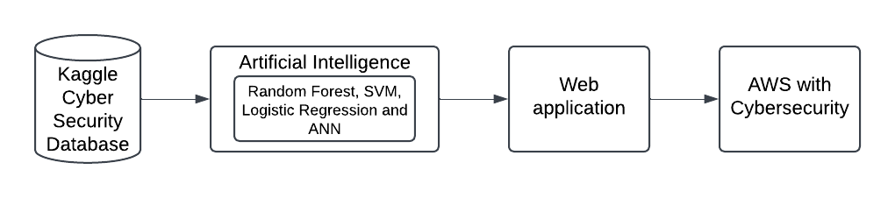
Methodology
Figure.2 Block Diagram
The above block diagram (Figure.2) shows the overall components included in this proposed project.
Kaggle Database: The initial stage involves accessing data from a Kaggle dataset, which serves as the foundation for training and testing the AI models.
Artificial Intelligence: Advanced AI algorithms process the dataset to detect and predict potential threats, creating an intelligent layer for decision-making.
Web Application & AWS with Cybersecurity: The processed data is integrated into a secure web application hosted on AWS, leveraging robust cybersecurity protocols to manage threats effectively.

Slide 11
Dataset Description
Dataset Link: https://www.kaggle.com/datasets/ramoliyafenil/text-based-cyber-threat-detection/data
Includes network traffic, textual messages, and entity relationships for threat detection.
Supports threat detection, incident response, and advanced ML/DL applications.
Contains IDs, text, labels, diagnoses, and solutions for threats.
Ready-to-use refined datasets optimized for analysis and training.

Slide 12
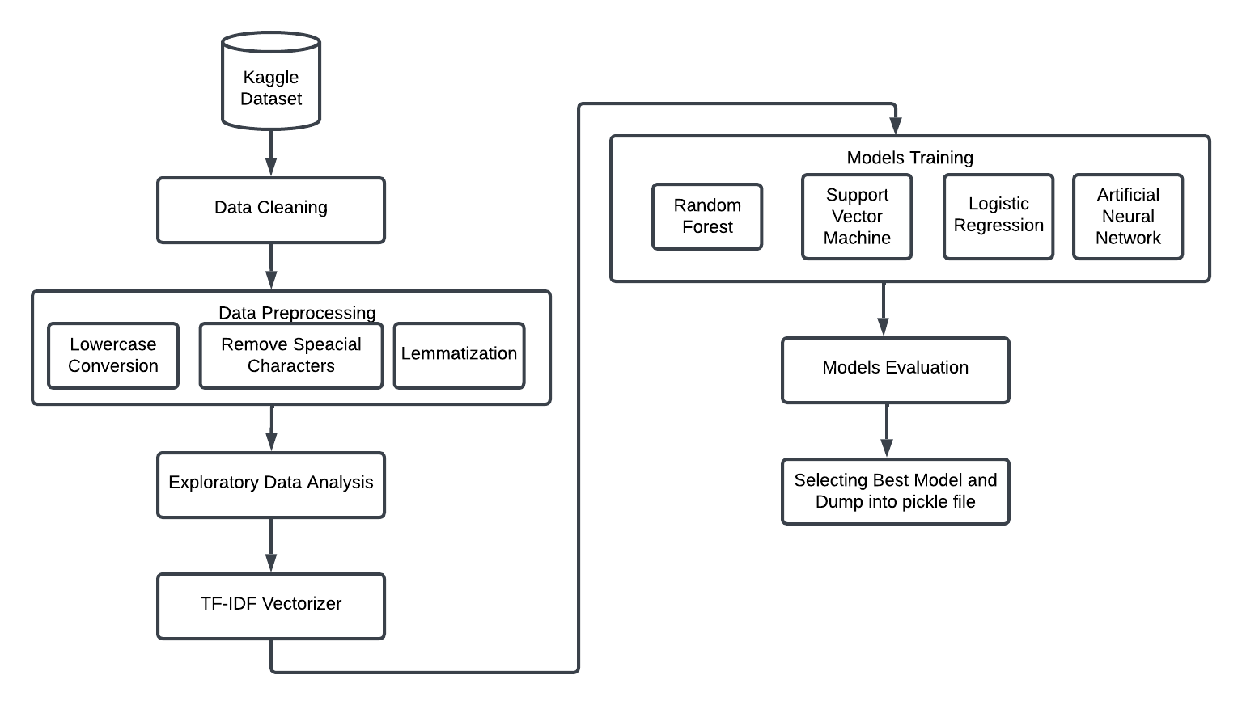
Threat Detection Using AI
Figure.3 Flow diagram of AI Component

Slide 13
Methodology
The flow of AI component is shown in previous and explained in the below (Figure.3) :
Kaggle Dataset: The process begins with acquiring a dataset from Kaggle, containing cyber threat-related data for analysis and model training.
Data Cleaning: Removes inconsistencies, duplicates, or irrelevant data to ensure the dataset is ready for preprocessing.
Data Preprocessing:
Lowercase Conversion: Converts text to lowercase for uniformity.
Remove Special Characters: Eliminates unwanted symbols or characters to simplify text.
Lemmatization: Reduces words to their base or root form for better analysis.
Exploratory Data Analysis (EDA): Analyzes the cleaned dataset to uncover patterns, trends, and potential insights for better understanding.
TF-IDF Vectorizer: Converts textual data into numerical form by assigning weights based on term frequency and document frequency for use in machine learning models.

Slide 14
Methodology
Model Training: Trains four machine learning models (Random Forest, Support Vector Machine, Logistic Regression, and Artificial Neural Network) using the vectorized data.
Model Evaluation: Evaluates the performance of all trained models using metrics such as accuracy, precision, recall, and F1-score.
Selecting the Best Model: Compares the evaluation results to identify the best-performing model.
Dumping the Model: Saves the best model into a pickle file for future use or deployment.
Outcome: The process results in a robust machine learning model ready for deployment in detecting cyber threats effectively.

Slide 15
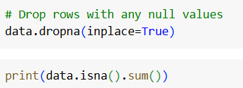
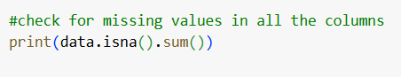
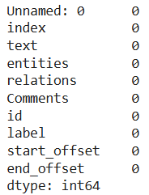
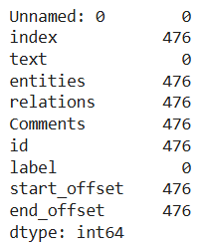
Handling missing values
The below figures shows, number of missing values (Figure.4) in each column and cleaned data(Figure.5).
Figure.4 Number of missing values
Figure.5 Missing values after cleaning

Slide 16
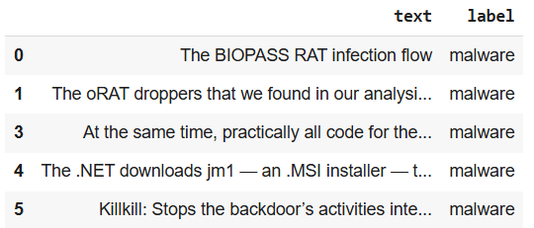
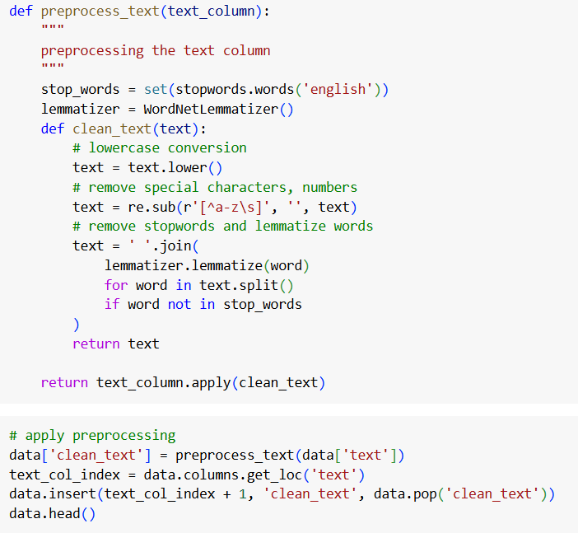
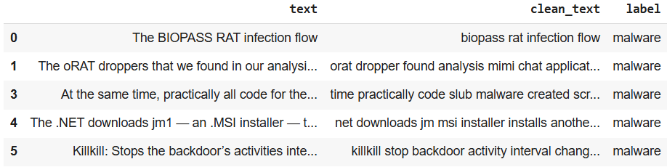
Pre-processed Data
Figure.6 Original Dataframe
Below figures show that sample original data(Figure.6) and pre-processed data(Figure.8). The following pre-processing steps are performed such as, converting into lower case, removing special character and lemmatization (Figure.7).
Figure.8 Cleaned Dataframe
Figure.7 Pre-processing code

Slide 17
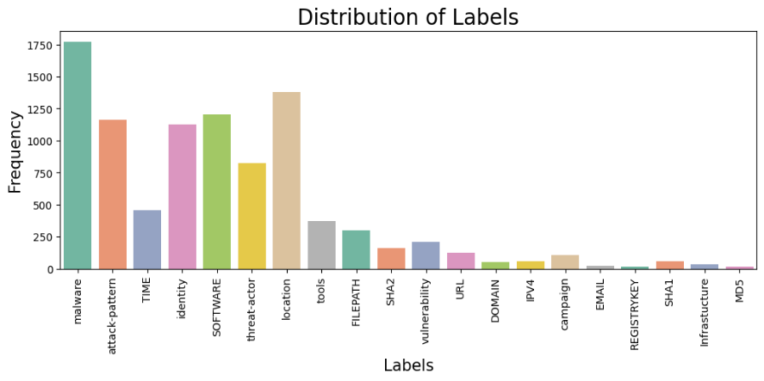
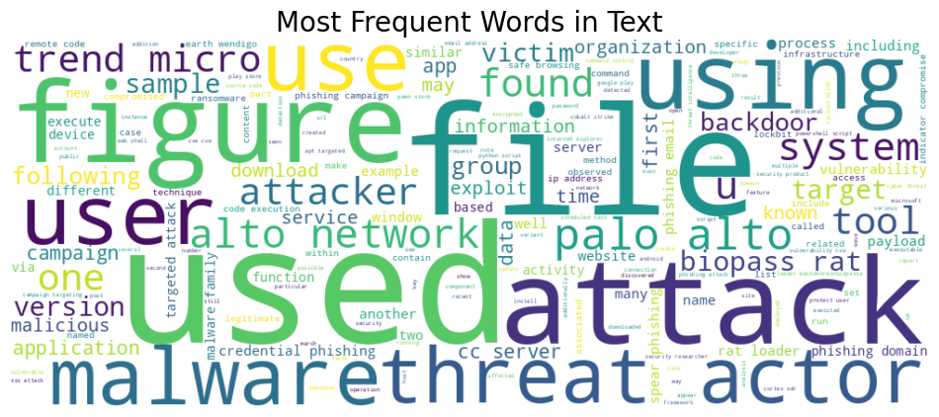
Exploratory Data Analysis
The chart shows that "malware" is the most frequently occurring label, indicating a primary focus on malware-related threats in the dataset. In contrast, labels like "tools" and "threat-actor" have significantly lower frequencies, highlighting less representation and potential areas for further data collection or model refinement(Figure.9).
The word cloud highlights common cybersecurity terms such as "attack," "malware," "threat," and "phishing," emphasizing the dataset's focus on cyber threats. Additional terms like "tool," "technique," and "campaign" suggest an analysis of attack strategies and methods(Figure.10).
Figure.9 Distribution of Labels
Figure.10 Most Frequent Words in Text

Slide 18
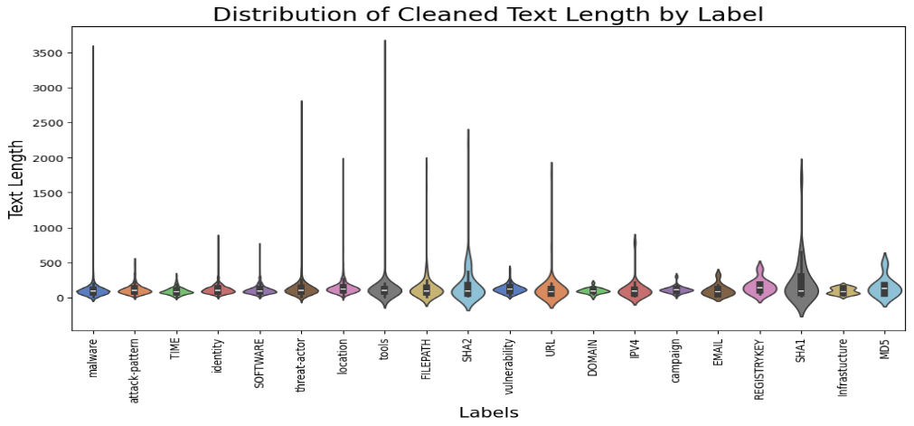
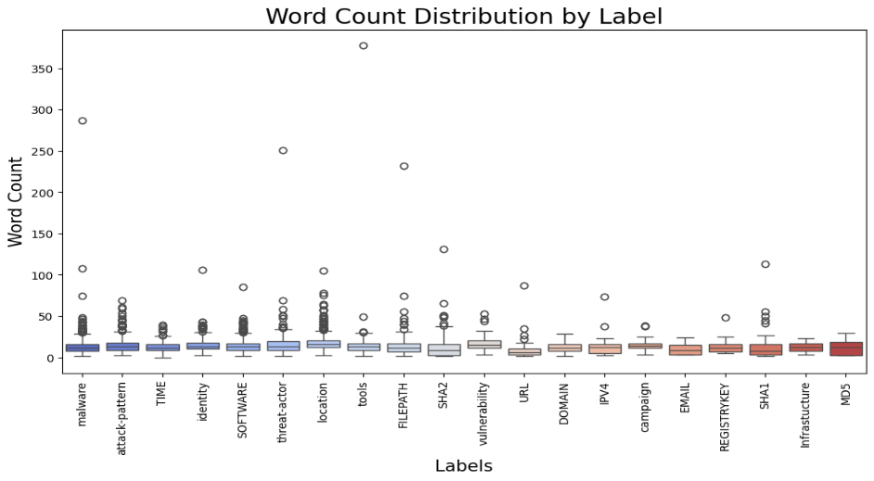
Exploratory Data Analysis
The violin plot displays the distribution of cleaned text lengths for different labels. Labels such as "malware" and "SHA2" have wider distributions and longer text descriptions, indicating detailed entries, while labels like "EMAIL" and "DOMAIN" have shorter and more concise text(Figure.11).
The distribution highlights significant variations in text lengths among labels. Categories like "SHA1" and "Infrastructure" show longer text descriptions, suggesting complex data, while labels like "campaign" and "IPV4" exhibit shorter descriptions, indicating more straightforward entries(Figure.12).
Figure.11 Distribution of cleaned text length by label
Figure.12 Word count distribution by label

Slide 19
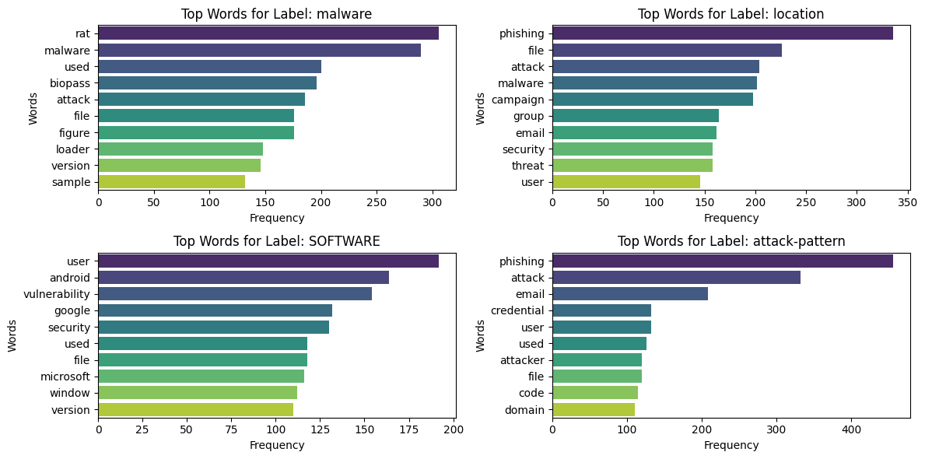
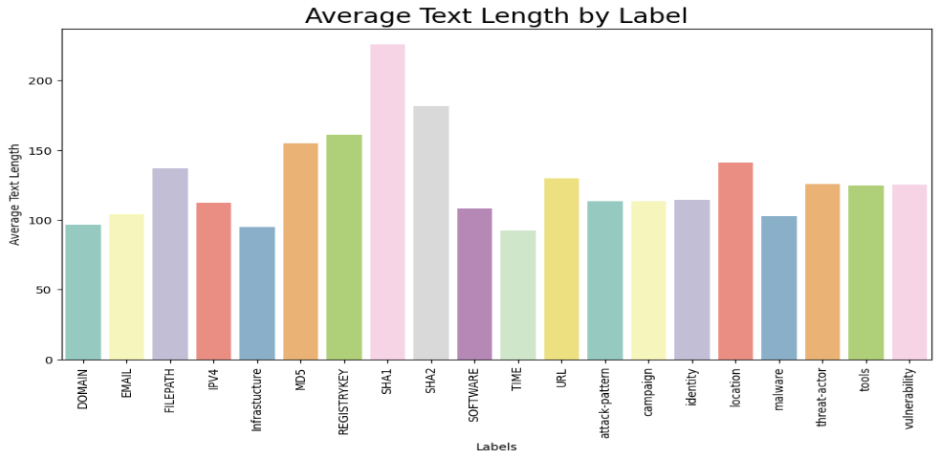
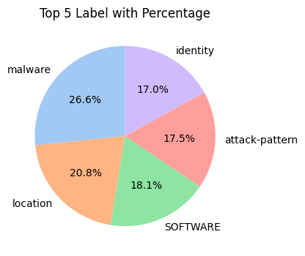
Exploratory Data Analysis
The pie chart shows the top 5 labels in the dataset with their percentages. "Malware" constitutes the largest share at 26.6%, followed by "location" (20.8%), while "identity" is the smallest among the top labels with 17%(Figure.13).
The bar charts highlight the most frequent words associated with specific labels. For example, "phishing" and "attack" are common in "location" and "attack-pattern" labels, while "rat" and "malware" dominate the "malware" label, emphasizing their relevance in cyber threat contexts(Figure.14).
The bar chart shows the average text length for each label, with "SHA1" and "REGISTRYKEY" having the longest descriptions, indicating more detailed entries. Labels like "DOMAIN" and "EMAIL" have shorter average lengths, reflecting concise text data(Figure.15).
Figure.14 Top 4 threats and it top frequent words
Figure.13 Top 5 label with percentage
Figure.15 Average Text Length by label

Slide 20
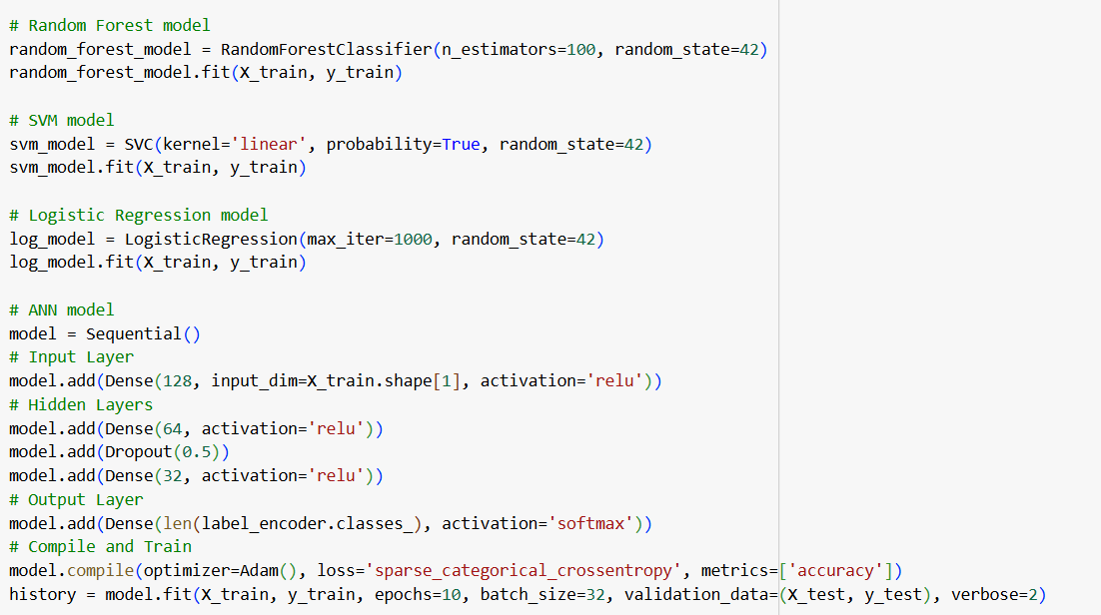
Experimentation of Models
The below figure shows that experimentation of each model using python (Figure.16).
Figure.16 Model Implementation

Slide 21
Hyperparameters
1. Random Forest Model:
n_estimators=100: This defines the number of decision trees the Random Forest will build. A higher number improves model performance but increases computation time.
random_state=42: Ensures reproducibility by controlling the randomness used during tree construction and sampling.
2. Support Vector Machine (SVM) Model:
kernel='linear': Specifies the kernel type used in the SVM algorithm. The linear kernel is suitable for data that is linearly separable.
probability=True: Enables probability estimates for each class, useful for calculating metrics like AUC.
random_state=42: Ensures consistent results by fixing the randomness in the training process.
3. Logistic Regression Model:
max_iter=1000: Sets the maximum number of iterations allowed for the solver to converge. A higher value is often required for complex datasets.
random_state=42: Ensures reproducibility of the logistic regression training process.

Slide 22
Hyperparameters
4. Artificial Neural Network (ANN) Model:
Layers and Units:
Input Layer: Has 128 neurons with ReLU activation, matching the feature dimensions of the input data.
Hidden Layer 1: Includes 64 neurons with ReLU activation.
Dropout(0.5): Introduces regularization by randomly dropping 50% of neurons during training to prevent overfitting.
Hidden Layer 2: Includes 32 neurons with ReLU activation.
Output Layer: Uses a softmax activation function to handle multi-class classification.
Compilation Parameters:
optimizer='Adam': Adaptive optimizer that adjusts learning rates for efficient convergence.
loss='sparse_categorical_crossentropy': Appropriate loss function for multi-class classification with integer labels.
epochs=10: Specifies that the model will train for 10 iterations over the entire dataset.
batch_size=32: Splits data into batches of 32 samples for training to balance computation and efficiency.
validation_data=(X_test, y_test): Uses test data to evaluate model performance during training.

Slide 23
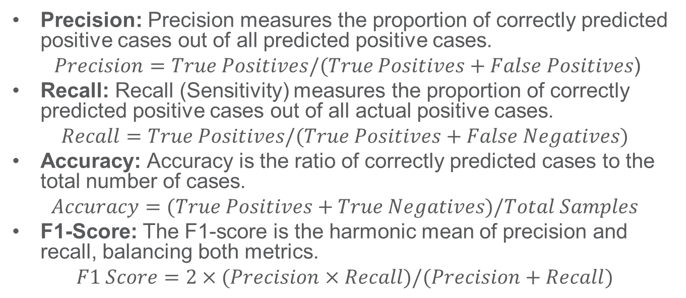
Evaluation Metrics
Precision: Precision measures the proportion of correctly predicted positive cases out of all predicted positive cases.
$Precision=True Positives/(True Positives+False Positives$)
Recall: Recall (Sensitivity) measures the proportion of correctly predicted positive cases out of all actual positive cases.
$$Recall=True Positives/(True Positives+False Negatives)$$
Accuracy: Accuracy is the ratio of correctly predicted cases to the total number of cases.
$$Accuracy=(True Positives+True Negatives)/Total Samples$$
F1-Score: The F1-score is the harmonic mean of precision and recall, balancing both metrics.
$$F1 Score=2×(Precision×Recall)/(Precision+Recall)$$

Slide 24
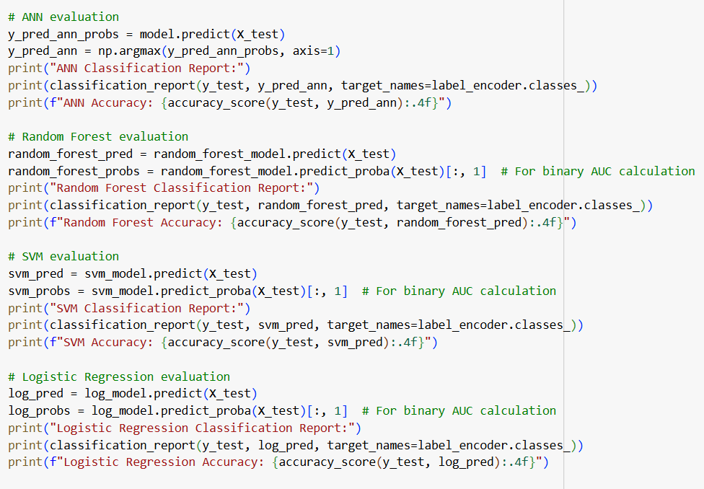
Experimentation of Models Evaluation
The code evaluates multiple machine learning models, including ANN, Random Forest, SVM, and Logistic Regression, using accuracy scores and classification reports(Figure.17).
Each model's predictions are tested against the actual labels, and their performance is summarized using metrics such as precision, recall, F1-score, and overall accuracy.
The results include binary probabilities for models like Random Forest and SVM to calculate metrics like AUC, enhancing detailed performance analysis.
Figure.17 Model Evaluation

Slide 25
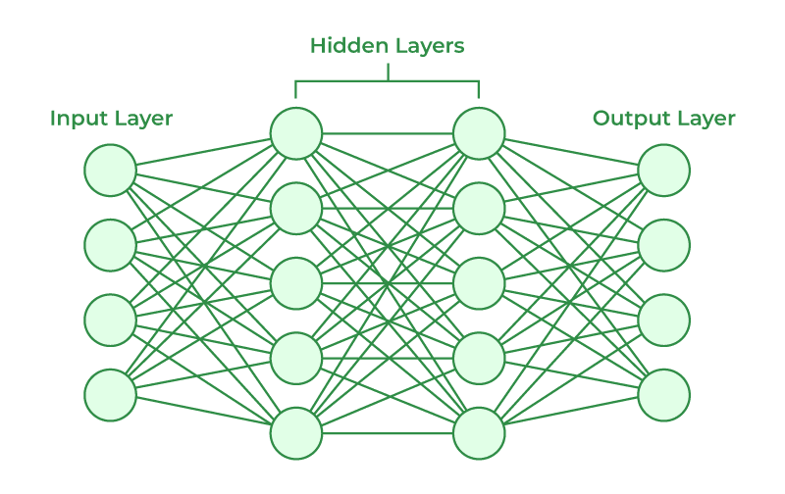
ANN model
The Artificial Neural Network (ANN) model is designed to mimic the human brain's neural network, effectively identifying complex patterns in data(Figure.18).
It consists of input, hidden, and output layers with interconnected neurons, where each layer processes features and learns relationships to improve classification or prediction accuracy.
In this project, the ANN model is trained on preprocessed data to classify threats, utilizing techniques like activation functions and dropout layers to enhance performance and avoid overfitting.
(Y=W1X1+W2X2+b).
This summed function is applied over an Activation function. The output from this neuron is multiplied with the weight W3 and supplied as input to the output layer. The same process happens in each neuron, but we vary the activation functions in hidden layer neurons, not in the output layer.
Figure.18 ANN architecture(GeeksforGeeks 2024)

Slide 26
Model Evaluation - ANN
Class Name | Precision | Recall | F1-score
DOMAIN | 1 | 0.75 | 0.86
EMAIL | 0.8 | 1 | 0.89
FILEPATH | 0.77 | 0.88 | 0.82
IPV4 | 0.85 | 1 | 0.92
Infrastucture | 1 | 1 | 1
MD5 | 0 | 0 | 0
REGISTRYKEY | 1 | 1 | 1
SHA1 | 1 | 0.69 | 0.82
SHA2 | 0.9 | 0.71 | 0.79
SOFTWARE | 0.92 | 0.88 | 0.9
TIME | 0.78 | 0.82 | 0.8
URL | 1 | 0.95 | 0.97
attack-pattern | 0.86 | 0.9 | 0.88
campaign | 0.73 | 0.83 | 0.78
identity | 0.88 | 0.89 | 0.88
location | 0.85 | 0.85 | 0.85
malware | 0.94 | 0.9 | 0.92
threat-actor | 0.86 | 0.93 | 0.89
tools | 1 | 0.91 | 0.95
vulnerability | 0.83 | 0.88 | 0.85
accuracy | 0.88
macro avg | 0.85 | 0.84 | 0.84
weighted avg | 0.88 | 0.88 | 0.88
The table presents the evaluation metrics (Precision, Recall, F1-score) for an Artificial Neural Network (ANN) model across various class labels in a cybersecurity context.
It highlights the model's performance, with overall accuracy of 0.88, macro average F1-score of 0.84, and weighted average F1-score of 0.88 across 1893 instances.
This ANN model trained for 10 Epochs.

Slide 27

Random Forest
Combines multiple decision trees for better accuracy and reduced overfitting (Figure.19).
Uses random subsets of data and features to train each tree.
Final predictions are based on majority voting or averaging.
Performs well on large datasets and reduces the impact of overfitting.
Figure.19 Random Forest Architecture(Anas Brital | Random Forest algorithm explained . n.d.)

Slide 28
Model Evaluation – Random Forest
Class Name | Precision | Recall | F1-score
DOMAIN | 1 | 0.75 | 0.86
EMAIL | 1 | 1 | 1
FILEPATH | 1 | 0.8 | 0.89
IPV4 | 1 | 1 | 1
Infrastucture | 1 | 0.75 | 0.86
MD5 | 1 | 0.5 | 0.67
REGISTRYKEY | 1 | 1 | 1
SHA1 | 0.69 | 0.69 | 0.69
SHA2 | 0.64 | 0.79 | 0.71
SOFTWARE | 0.9 | 0.9 | 0.9
TIME | 0.98 | 0.84 | 0.9
URL | 1 | 0.95 | 0.97
attack-pattern | 0.89 | 0.88 | 0.89
campaign | 0.71 | 0.87 | 0.78
identity | 0.91 | 0.89 | 0.9
location | 0.89 | 0.87 | 0.88
malware | 0.9 | 0.94 | 0.92
threat-actor | 0.87 | 0.96 | 0.91
tools | 0.97 | 0.96 | 0.97
vulnerability | 0.81 | 0.91 | 0.86
accuracy | 0.9
macro avg | 0.91 | 0.86 | 0.88
weighted avg | 0.9 | 0.9 | 0.9
The table displays the evaluation metrics (Precision, Recall, F1-score) for a Random Forest model applied to a multi-class classification problem.
The model achieves an overall accuracy of 0.90, with macro-average F1-score of 0.88 and weighted-average F1-score of 0.90, indicating strong performance across most classes.

Slide 29
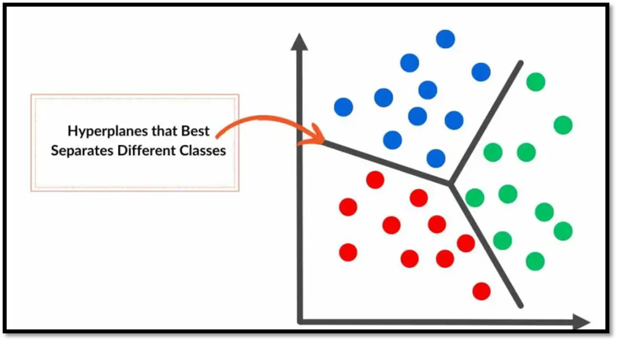
SVM
SVM separates data into classes using a hyperplane with maximum margin(Figure.20).
It is effective for both linear and non-linear classification tasks.
Kernel functions enable SVM to handle complex data transformations.
SVM works well with high-dimensional data and smaller datasets.
Figure.20 SVM Prediction(Alam 2024)

Slide 30
Model Evaluation – SVM
Class Name | Precision | Recall | F1-score
DOMAIN | 1 | 0.33 | 0.5
EMAIL | 1 | 1 | 1
FILEPATH | 0.79 | 0.67 | 0.72
IPV4 | 0.88 | 0.64 | 0.74
Infrastucture | 1 | 0.12 | 0.22
MD5 | 0 | 0 | 0
REGISTRYKEY | 0.67 | 1 | 0.8
SHA1 | 1 | 0.46 | 0.63
SHA2 | 0.81 | 0.45 | 0.58
SOFTWARE | 0.76 | 0.85 | 0.8
TIME | 0.84 | 0.72 | 0.78
URL | 0.91 | 0.5 | 0.65
attack-pattern | 0.72 | 0.77 | 0.74
campaign | 0.71 | 0.74 | 0.72
identity | 0.83 | 0.78 | 0.8
location | 0.68 | 0.74 | 0.71
malware | 0.78 | 0.87 | 0.82
threat-actor | 0.84 | 0.82 | 0.83
tools | 0.86 | 0.64 | 0.73
vulnerability | 0.67 | 0.88 | 0.76
accuracy | 0.77
macro avg | 0.79 | 0.65 | 0.68
weighted avg | 0.78 | 0.77 | 0.77
The table evaluates the SVM model's performance across multiple classes, showing an overall accuracy of 0.77 with a macro-average F1-score of 0.68. While some classes, like "EMAIL" and "SOFTWARE," perform well, others like "DOMAIN" and "Infrastructure" show lower recall, indicating room for improvement.

Slide 31
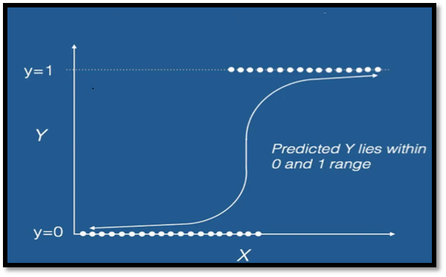
Logistic Regression
Logistic Regression predicts probabilities for binary or multi-class outcomes(Figure.21).
It uses the sigmoid function to map predictions to probabilities.
The model estimates relationships between input features and a categorical target variable.
Logistic Regression is simple, efficient, and works well with linearly separable data.
Figure.21 Logistic Regression Prediction (Rajput 2018)

Slide 32
Model Evaluation – Logistic Regression
Class Name | Precision | Recall | F1-score
DOMAIN | 0 | 0 | 0
EMAIL | 1 | 0.5 | 0.67
FILEPATH | 0.76 | 0.44 | 0.56
IPV4 | 1 | 0.18 | 0.31
Infrastucture | 0 | 0 | 0
MD5 | 0 | 0 | 0
REGISTRYKEY | 1 | 0.25 | 0.4
SHA1 | 0 | 0 | 0
SHA2 | 0.5 | 0.05 | 0.1
SOFTWARE | 0.67 | 0.81 | 0.73
TIME | 0.89 | 0.48 | 0.63
URL | 0.86 | 0.3 | 0.44
attack-pattern | 0.64 | 0.74 | 0.68
campaign | 1 | 0.13 | 0.23
identity | 0.76 | 0.74 | 0.75
location | 0.58 | 0.68 | 0.62
malware | 0.65 | 0.87 | 0.75
threat-actor | 0.79 | 0.75 | 0.77
tools | 0.87 | 0.34 | 0.49
vulnerability | 0.53 | 0.52 | 0.52
accuracy | 0.68
macro avg | 0.62 | 0.39 | 0.43
weighted avg | 0.69 | 0.68 | 0.66
The Logistic Regression model demonstrates an overall accuracy of 0.68 with a weighted average F1-score of 0.66.
However, it performs poorly in classes like "DOMAIN" and "Infrastructure" (F1-score of 0), while achieving relatively better performance in "SOFTWARE" and "malware" detection.

Slide 33
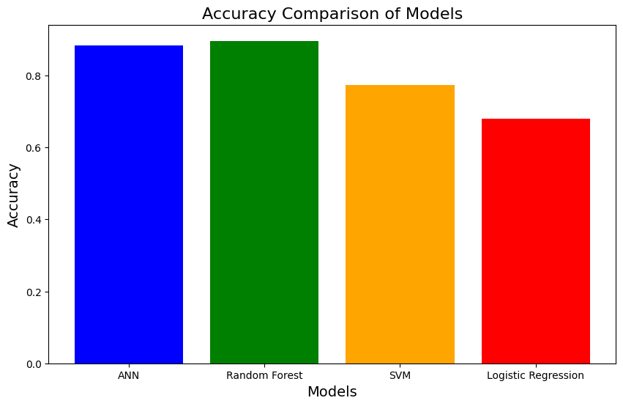
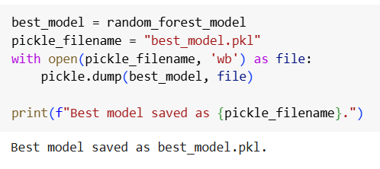
Model Comparison
The Random Forest Model outperform other models(Figure.22), so Random Forest model is selected as best model and deployed as pickle file for web application (Figure.23).
Models | Accuracy
ANN | 88.22%
Random Forest | 89.59%
SVM | 77.23%
Logistic Regression | 67.99%
Figure.22 Model accuracy comparison
Figure.23 Model deployment

Slide 34
Importance of Web application
Enhances Cybersecurity: Detects and mitigates potential threats by analyzing messages in real-time.
User Authentication & Security: Implements OTP-based authentication and user session management for secure access.
Scalable & Cloud-Based: Deployed on AWS EC2 for high availability, security, and performance.
Automated Threat Detection: Uses machine learning to identify and flag malicious messages.
Seamless User Experience: Provides a user-friendly interface for communication and threat reporting.
Centralized Management: Allows admins to monitor and manage users, threats, and system security.
Data Protection & Compliance: Ensures secure data storage and compliance with cybersecurity standards.
Real-Time Insights & Alerts: Notifies admins of potential threats, ensuring quick response and mitigation.

Slide 35
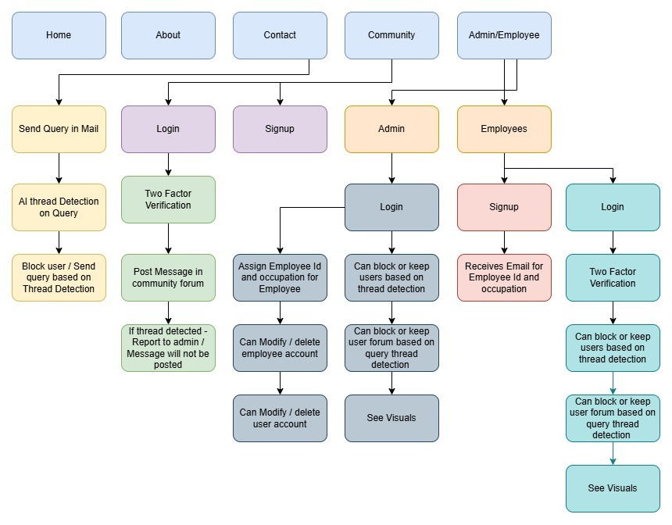
Web application
Figure.24 Web application Functionalities

Slide 36
Web application functionalities
Home, About Us, and Contact Us Pages: The platform features informational pages to introduce the website and provide contact details.
Contact Us Page: This page also includes sending query to admin, by entering the name, e-mail id with a query message, the AI part will detect threat on this query and the system will send query to admin if it is not detected as threat otherwise it will report to the admin and admin can block the user.
Community and Admin/Employees Pages: The system includes a Community Page for users to interact and an Admin Page for monitoring and management.
Community Page Login and Signup Options:
Login Button: Users enter their email, password, and user ID to log in.
Forgot Password Option: Sends an OTP to the registered email, allowing users to reset their password.
User Signup Process: Users fill in details like username, email, mobile number, password, confirm password, age, and gender. Upon successful signup, the system generates and displays an User ID for reference.
Duplicate Validation During Signup: The system checks if the username, email, or mobile number are already registered. If they are, it displays a message prompting the user to try different credentials.
Employees Login/Signup: Employees fill in details like username, email, mobile number, password, confirm password, age, and gender. Upon successful signup and successful verification of admin, the system admin will assign ad send Employee ID and occupation through registered mail..

Slide 37
Web application functionalities
Community Forum Access: After logging in, users can post messages and view others' messages on the Community Forum.
Threat Detection in Posts: The system analyzes user posts for potential threats:
Non-Threatening Messages: Displayed on the forum for all users.
Threatening Messages: Blocked from posting, reported to the admin, and not visible to users.
Admin Login: Admins can log in to the Admin Page to manage and review detected threats, detected threats from queries, assign employee id and occupation, edit/delete employees, edit users and see visuals.
Threat Monitoring Dashboard: Admins/Employees have access to a dashboard displaying threats in table and chart formats for comprehensive monitoring.
Threat Details in Table Format: The table lists username, message, and threat description, providing clear insights into flagged activities.

Slide 38
Web application functionalities
Permanent User Blocking: Admins can permanently block users from accessing the platform if their behavior violates the terms.
Blocked User Login Restriction: If a blocked user attempts to log in, the system displays a message stating, "You are blocked."
User-Friendly Password Reset: The Forgot Password functionality ensures a secure and seamless password recovery process through OTP verification.
User ID Management: The system automatically generates unique user IDs for users during signup, ensuring user identification and reference.
Enhanced Security: The platform emphasizes security by detecting malicious content, preventing threats from spreading, and giving admins control over user activities.

Slide 39
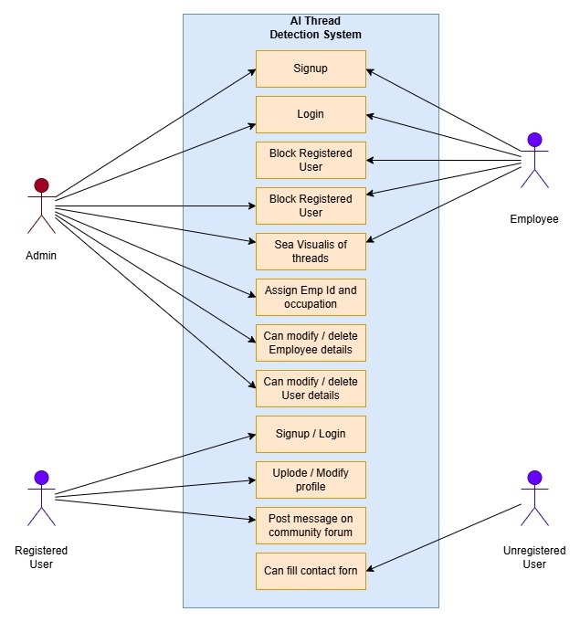
Use Case Diagram
Admin Role: The admin can manage user and employee data, including blocking users, modifying/deleting details, and assigning employee roles (ID and occupation). They also oversee system threads.
Employee Role: Employees can log in, view thread visuals, and perform tasks assigned by the admin related to thread monitoring or data updates.
Registered User: Registered users can sign up, log in, update their profiles, post on community forums, and engage with the system interactively.
Unregistered User: Unregistered users are limited to filling out contact forms to communicate or request access.
System Design: The "AI Threat Detection System" ensures clear role-based access and functionality, enhancing usability and security.
Figure.25 Web application Use Case Diagram

Slide 40
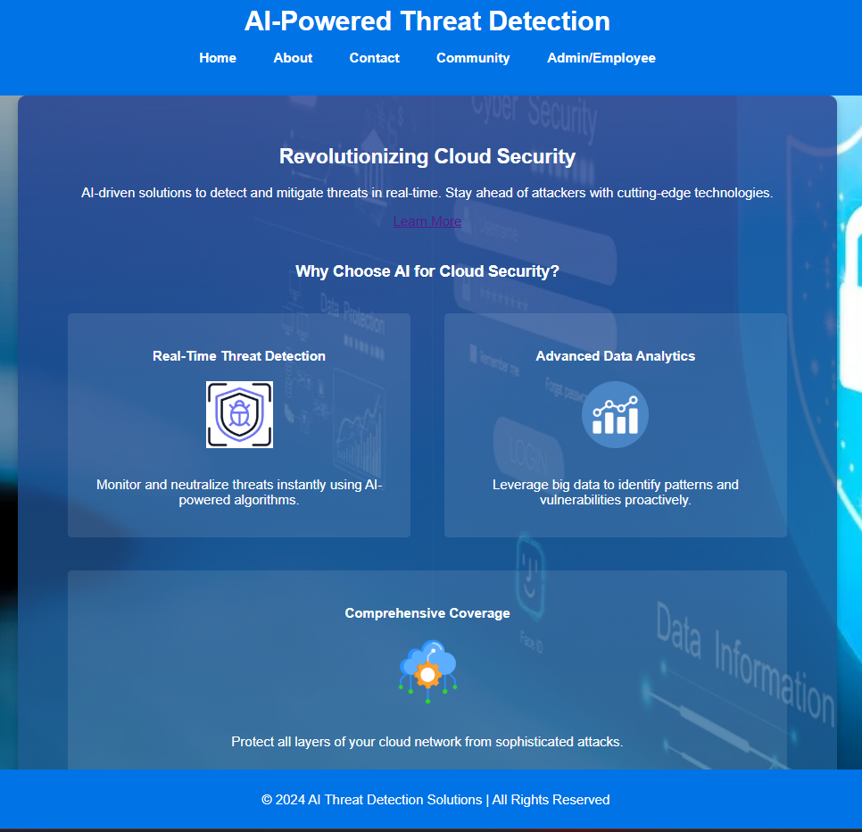
Home Page
Figure.26 Home Page
This home page consist of basic information about website and its usage(Figure.26).

Slide 41

About Us - Page
Figure.27 About us page
About team and the mission of the organization is mentioned is the about us page (Figure.27).

Slide 42
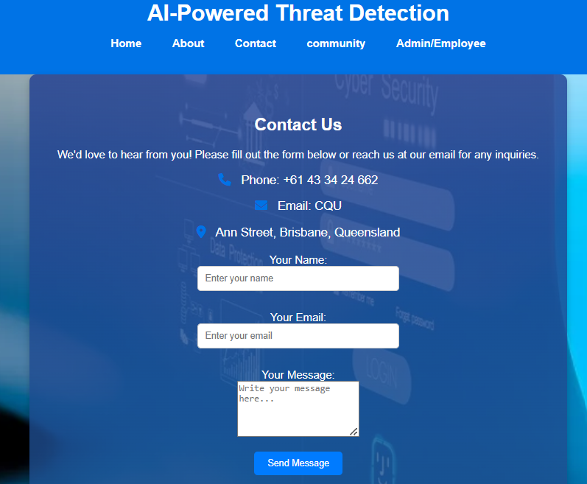
Contact us page
Contact information, such as phone number, address and email-id are mentioned in the contact us page (Figure.28).
The non-registered user can queries using the form showed in the figure, AI threat detection is applied in this text message and reports to admin
Figure.28 AI powered query form and contact page

Slide 43
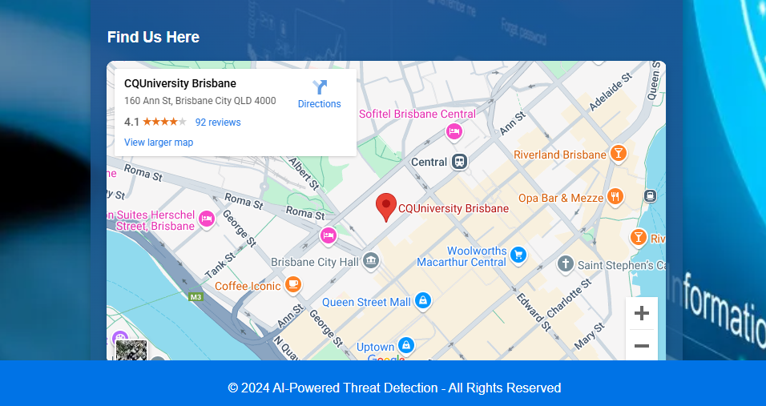
Find Us – Location page
The location of the organization is given in the form of google map, which is added as advanced feature in the contact us page(Figure.29).
Figure.29 Find us Location Page

Slide 44

Community Login/Signup Page
If the user clicks community Nav bar, then it will re directs to the community page, which has both login and signup buttons for the user(Employees) (Figure.30).
Figure.30 Community Login/Signup pages

Slide 45
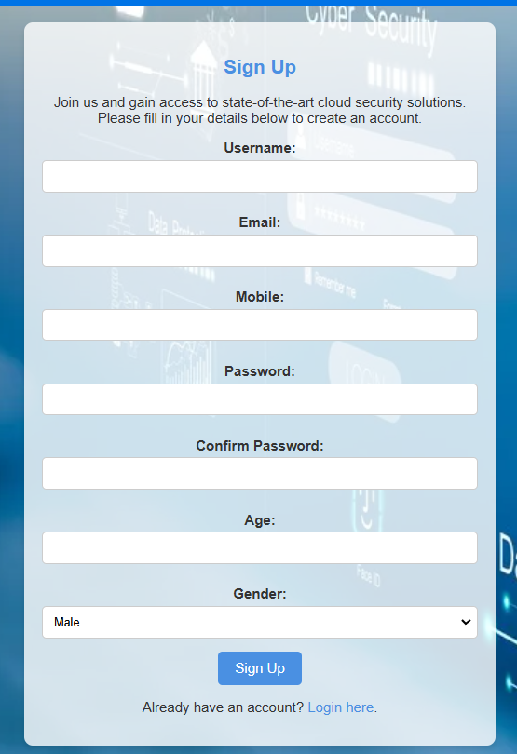
User Signup Page
If user clicks signup, it will redirect to the signup form, which has username, E-mail, Mobile number, password, confirm password, age and gender (Figure.31).
These fields includes the email validation and strong password validation.
Figure.31 Community user’s signup page

Slide 46
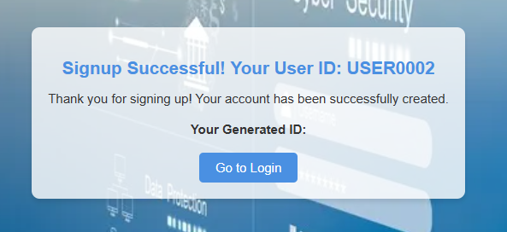
User ID Auto Generation
After successful signup with the input fields, the system will generate user id and notify the user to use while login into the account (Figure.32).
Figure.32 Generation of User ID

Slide 47
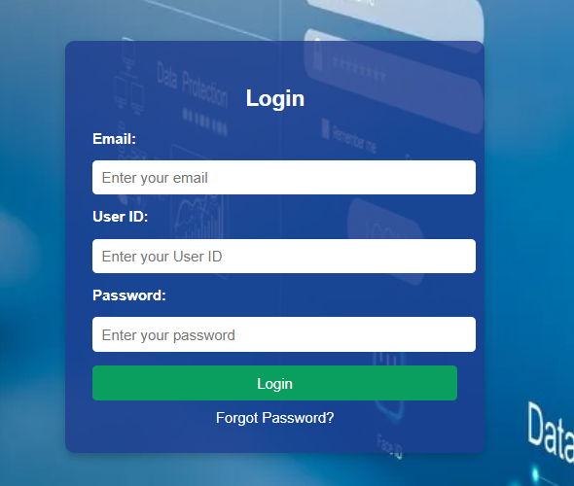
Login Page
After signing up, the user can login from the signup page also user can go to community nav bar and click login button(Figure.33).
The user must type their registered e-mail id, and employee id and then password.
This page has forgot functionality and also if the user forgot the password the they will get OTP to the registered mail id to reset the password.
Figure.33 Login page

Slide 48
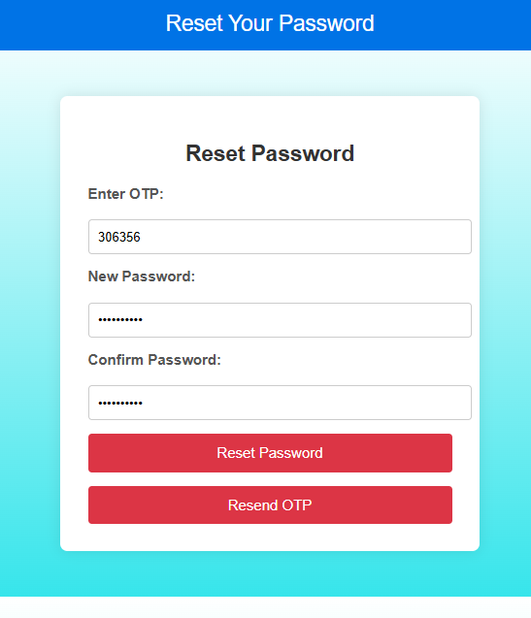
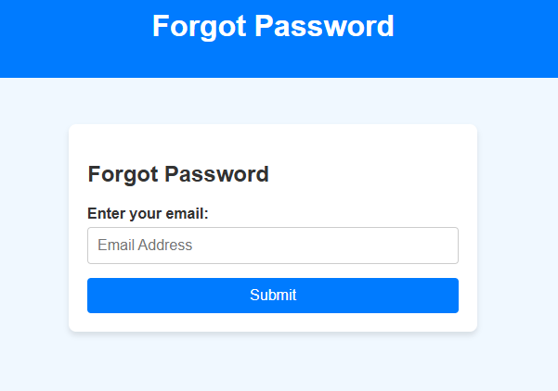
Forgot Password Page
If the user, clicks forgot password then user needs to enter their registered mail-id and need to enter OTP (Figure.34).
Then should enter the new password and confirm the password again(Figure.35).
Figure.35 Reset Password
Figure.34 Forgot Password

Slide 49
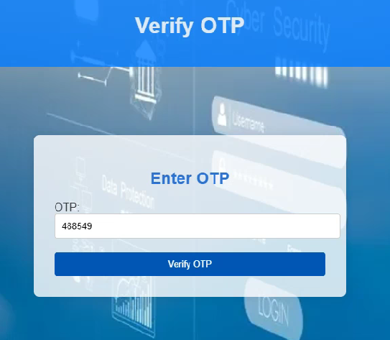
OTP Page (2-step verification)
After resetting the password or else, login with correct credential will redirect OTP page and then the system will send OTP from admin mail to the user’s registered mail id. After successful verification, it will redirect to the user account(Figure.36).
It will resend the OTP, if OTP is mismatch.
Figure.36 Verify OTP

Slide 50
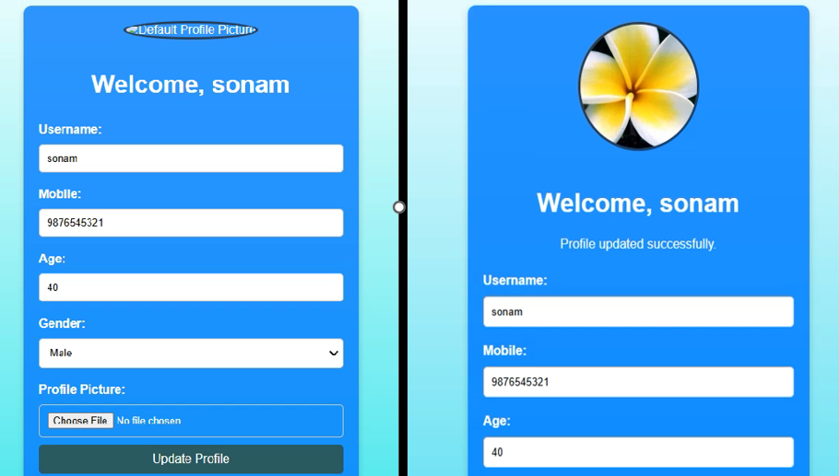
User Profile
Once the user is logged in after successful OTP verification, then user will redirect to the community account page, and it shows the profile page of the user and displays the welcome message(Figure.37).
User can edit update their profile also can be able to upload profile photo.
Figure.37 Editing user profile

Slide 51
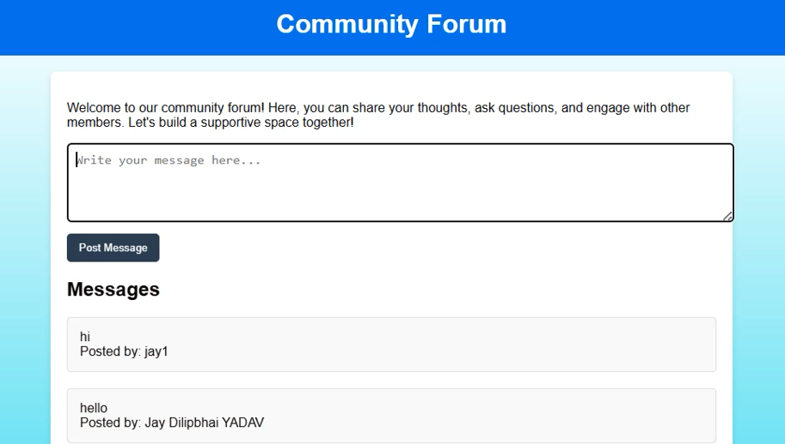
Community Forum
In this page the user can, post their message, thoughts etc. (Figure.38).
Also, the user can see their post and posts done by the other users.
Figure.38 Community portal with user messages

Slide 52
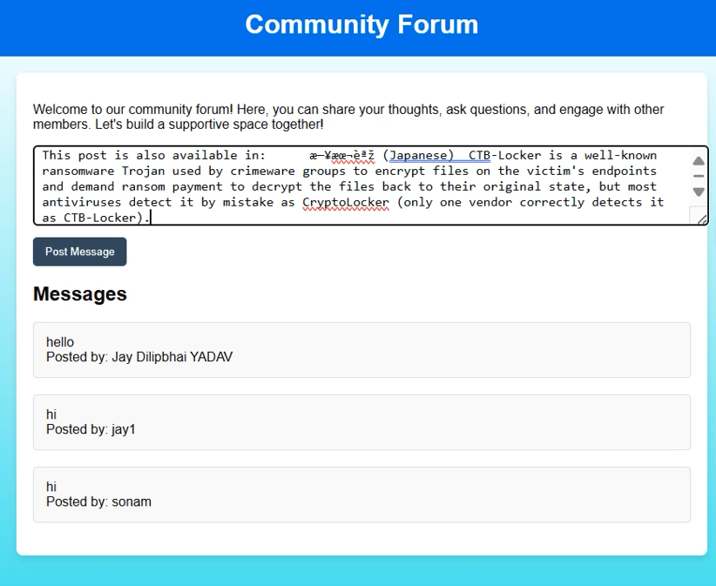
Posting Message
This screenshot shows that, text typed by the user. If user clicks post message, then, then typed text will be cleaned, pre-processed, vectorized and then it will be predicted using Random Forest trained model.
If the text is detected as threat, then the message will not be posted in the community forum and then the system will directly report to the admin (Figure.39).
Figure.39 Community portal with user messages

Slide 53
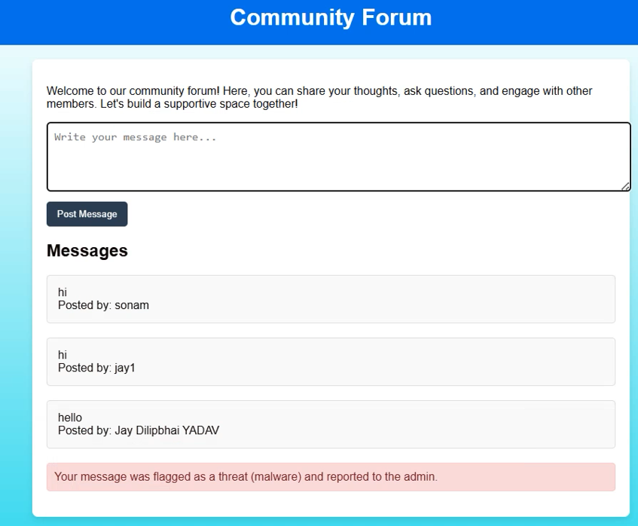
Updated Community Forum
The system notifies the user as the posted message was predicted as threat and it was flagged and reported to the admin(Figure.40).
Figure.40 Community portal with user messages with AI detection

Slide 54
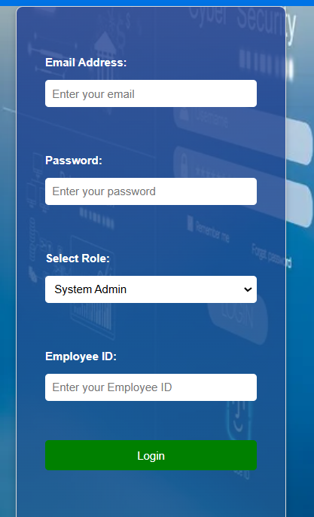
Admin Login Page
This system has only one admin account, and it has following credentials(Figure.41):
Email-id: jayy3685@gmail.com
ID: ADM
Password: admin1234
Figure.41 Admin Login page

Slide 55
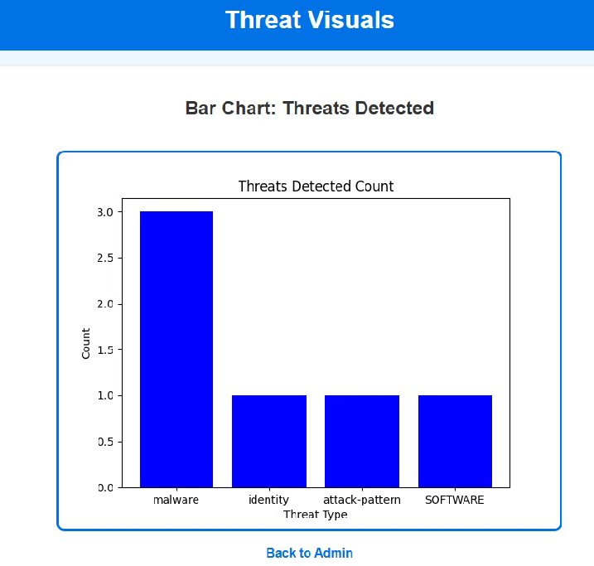
Admin (Statistics – Bar Chart)
If the admin clicks show visuals button, then admin can see graphical representation for distribution of detected threats with its categories(Figure.42).
Figure.42 Threat Visuals

Slide 56
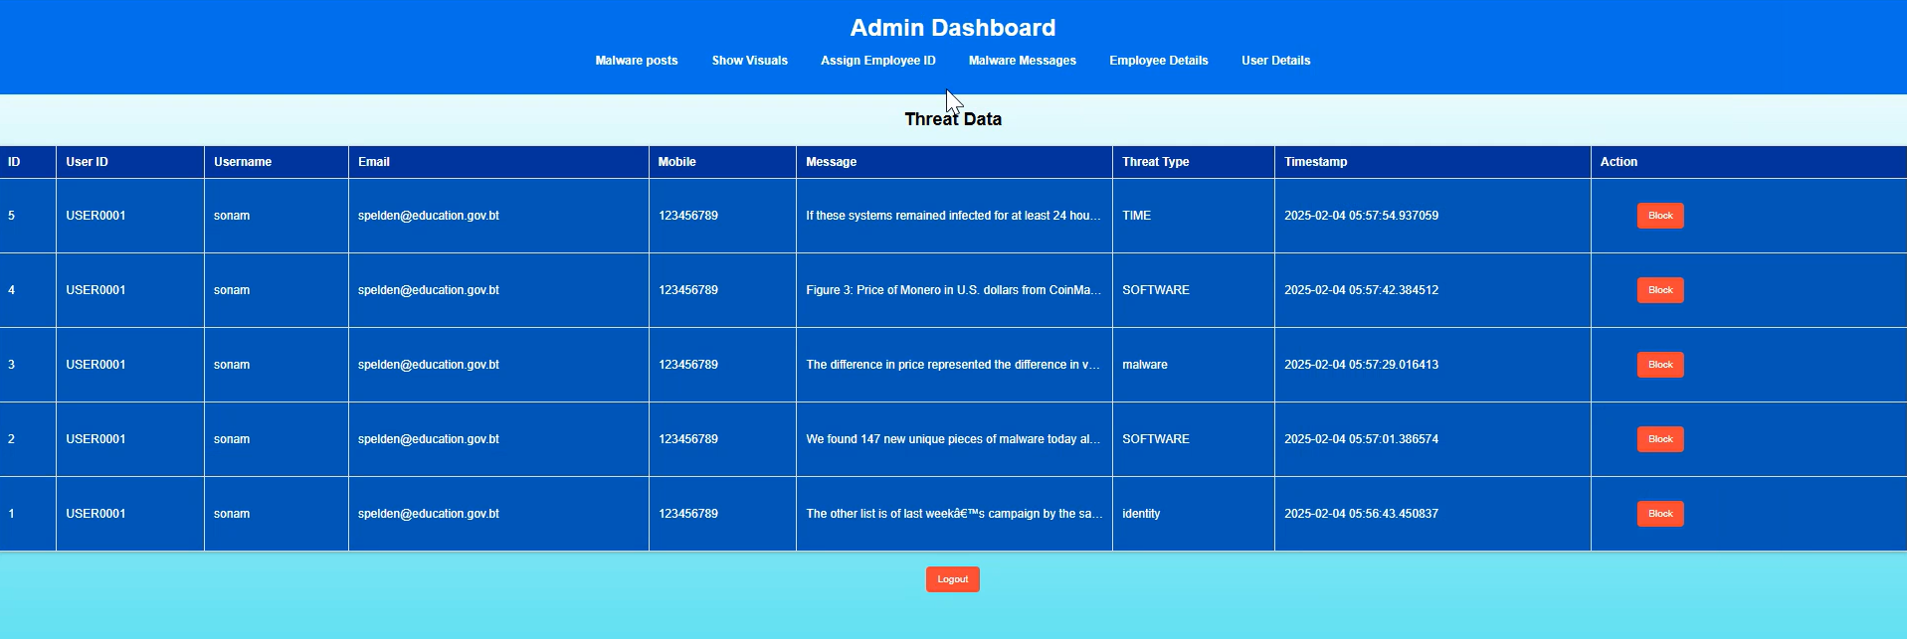
Admin Dashboard
Admin dashboard list the number of records that are detected as threats with their ids and details. If admin clicks block button in the particular row then the respective user will be blocked permanently and they unable to login.
Figure.43 Detected Threats with Block Functionality in Admin Dashboard

Slide 57
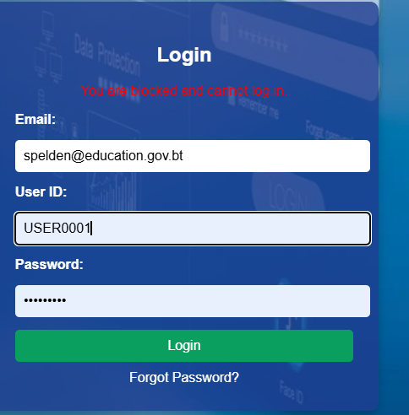
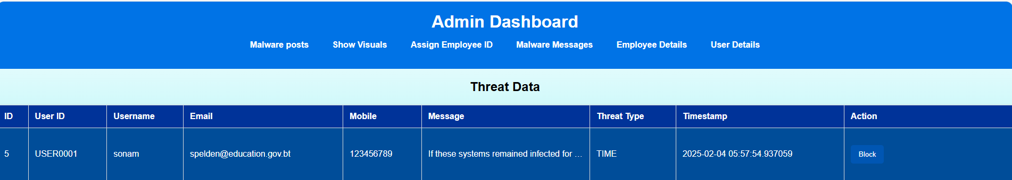
Block user for malware posts on community page
Admin has right to block the user by clicking on block button for posting malware messages on community page. Once the user is blocked user won’t be able to login again by checking is_blocked status in user table as shown in code in Figure 44.
Figure.44 Block user for malware posts on community page

Slide 58
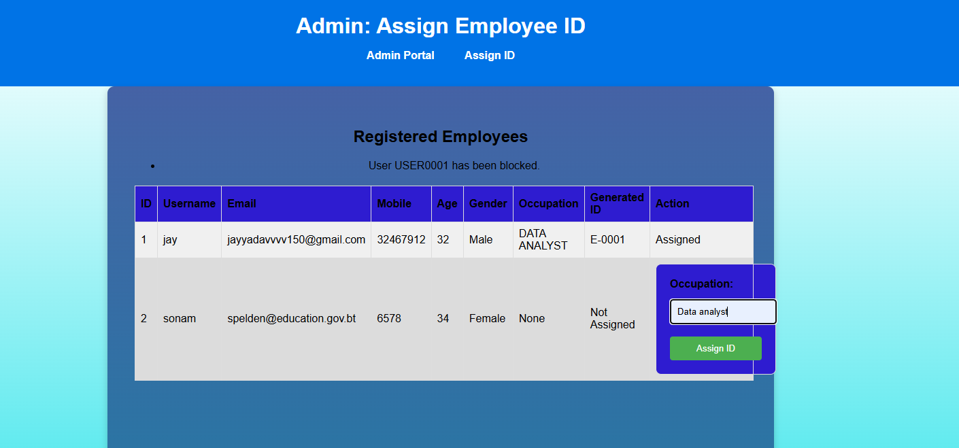
Assign employee id and occupation
After successful signup of employee all the details related to employees are displayed on assign employee id page in the form of table on admin portal. Admin will assign employee id and occupation manually by writing in text box as shown in Figure 45 given below. Employees will get email with employee id and occupation detail that they can use during login to the employee dashboard.
Figure.45 Assign employee id and occupation

Slide 59
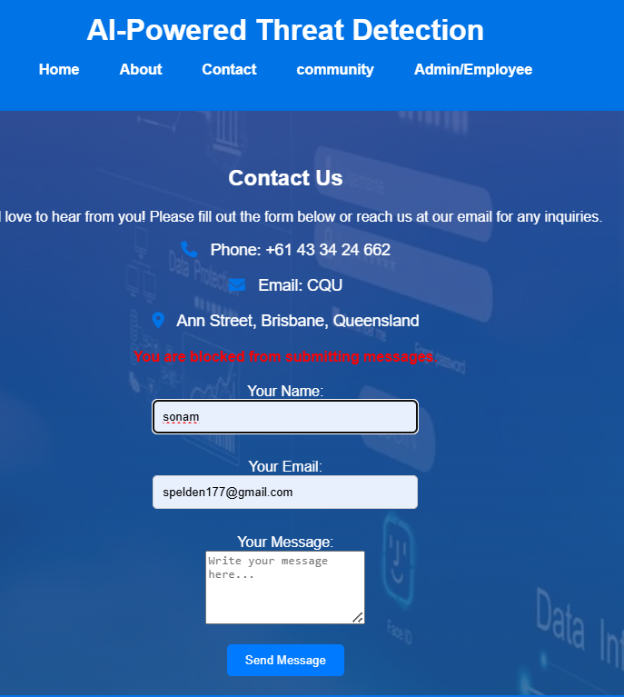
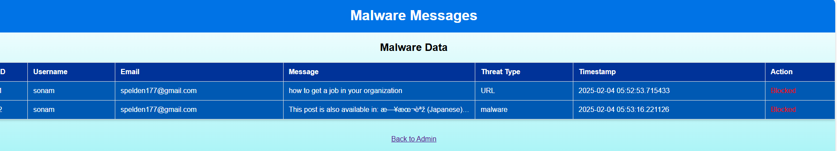
Block the user for malware query through contact page
Admin malware query page displays the details of users who has sent malware query through contact page with block button. When admin click on block user is blocked from sending query through contact page as shown in Figure 46.
Figure.46 Block the user for malware query through contact page

Slide 60
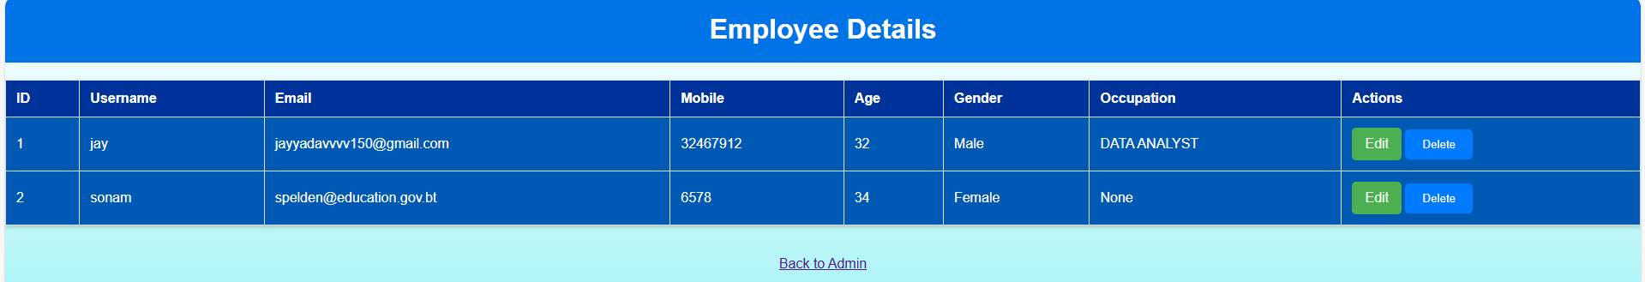
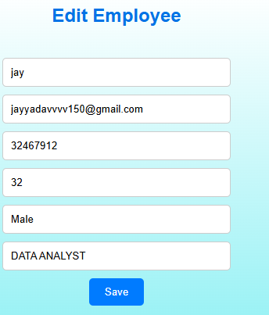

Edit and delete employee’s detail
The admin page also allows editing and deletion of the employee's relevant details. The admins could edit the employee form as would be required or delete it permanently. This will allow for correct and updated management of employees within the system using the code given in Figure 47.
There are two buttons edit and delete, if admin clicks on edit admin is redirected to edit employee page where admin can change any field related to employee information but if admin click on delete it will permanently delete employee from system record.
Figure.47 Admin edit and delete employee’s functionality

Slide 61


Editing user detail
On this page all the relevant information related to users posting messages on community page is displayed using code in Figure 48 in the form of table with edit button. When admin clicks edit button admin is redirected to edit user page where information related to user can be updated.
Figure.48 Editing user detail

Slide 62

Employee login
On employee login page if employee selects the role as employee rather than system admin and enters the credential received on mail (employee id) then employee is navigated to employee dashboard(Figure.49). Employee dashboard shows the users detail in the form of table with block button who has posted the malware message on community forum. Employee dashboard has following functionality:
Block user for malware posts on community page
Show visuals related to threat data
Block the user for malware query through contact page.
Figure.49 Employee Login

Slide 63

Block user for malware posts on community page
Employees also have right to block the user by clicking on block button for posting malware messages on community page. Once the user is blocked user won’t be able to login again by checking is_blocked status in user table as shown in code in Figure 50.
Figure.50 Employee block user functionality

Slide 64

Block the user for malware query through contact page
Employee malware query page displays the details of users who has sent malware query through contact page with block button. When employee click on block user is blocked from sending query through contact page as shown in Figure 51.
Figure.51 Block malware query user

Slide 65

AWS Securities and Deployment in cloud
Virtual Private Cloud (VPC):
VPC itself is generally free; however, specific components within the VPC can incur charges(Figure.52).
Elastic IP: Charged if not associated with a running instance.
The image shows the AWS Elastic ip address with summary of ip address, like the type of ip address, allocation id , scope, address pool, and network of elastic ip address . This elastic ip address we can assign to ec2 instance which we will create.
Figure.52 Virtual Private Cloud (VPC)

Slide 66

Virtual Private Cloud (VPC)
The image shows the AWS Elastic ip address with the name of val_app . we can assign the elastic ip to ec2 instance (Figure.53).
Figure.53 Virtual Private Cloud (VPC)

Slide 67

EC2 Instances
Hosts the web application and backend model.
The image shows the AWS EC2 instance management console. It highlights a single running instance (i-079d3f16936c8cadc) named vulnerability_app, with the instance type t2.small.
The instance is located in the us-east-1c availability zone, has passed its 2/2 status checks, and is associated with a public IPv4 address (3.224.206.40). Additional details are accessible under tabs like monitoring, security, and networking(Figure.54).
Figure.54 EC2 Instances

Slide 68

EC2 Instances
The image provides details about an AWS EC2 instance with ID i-079d3f16936c8cadc, labeled as vulnerability_app. It shows key attributes such as the instance type (t2.small), private IP DNS name, public elastic IP address (3.224.206.40), VPC ID, and Subnet ID. Additionally, it mentions options for AWS Compute Optimizer findings and lacks an associated IAM Role or Auto Scaling Group(Figure.55).
Figure.55 EC2 Instances

Slide 69

Amazon S3
Stores datasets and model files securely.
The image displays the Amazon S3 dashboard showing a bucket named `vulnerabilityapp-bucket2` in the `us-east-1` (US East, N. Virginia) region.
The bucket's creation date is December 24, 2024, at 22:06:15 . Options like "Copy ARN," "Empty," "Delete," and "Create bucket" are available for managing buckets(Figure.56).
Figure.56 Amazon S3

Slide 70

Amazon S3
The image shows the Amazon S3 upload interface for adding files to the `vulnerabilityapp-bucket2`.
A file named `test.txt` (0 bytes, plain text) is selected for upload. Users can drag and drop files, add folders, or manage selections using the provided buttons. The destination for the upload is clearly displayed (Figure.57).
Figure.57 Amazon S3

Slide 71

AWS Backup
Configured to automate backups for disaster recovery.
The image displays the "Backup plans" section in AWS Backup, showing one backup plan named "DisasterRecoveryPlan." This plan includes details such as the last modified date and time (December 24, 2024, 22:15:47 and no recorded last runtime. Options to create an on-demand backup or a new backup plan are also available(Figure.58).
Figure.58 AWS Backup

Slide 72

AWS Backup
The above image displays the details of a backup plan named weekly_backup in the AWS Backup service.
The plan has a monthly frequency, starting at 12:30 PM Brisbane time on the first day of the month, with a retention period of one month. Features like transitioning to cold storage, continuous backup, and EBS snapshot archiving are not enabled. The backups are stored in the Default backup vault and are not indexed (Figure.59).
Figure.59 AWS Backup

Slide 73

AWS Deployment
The deployed web application is available for anyone in the link: http://3.224.206.40:5000
Figure.60 AWS Deployment

Slide 74
Conclusion
The project successfully developed an AI-powered threat detection system that leverages machine learning to identify, classify, and mitigate cybersecurity threats in real time.
The system demonstrated strong model performance, with the Random Forest model achieving the best results in terms of accuracy and F1-score, making it ideal for deployment.
Preprocessing techniques like cleaning, lemmatization, and TF-IDF vectorization ensured the dataset was optimized for model training and evaluation.
The web application provides essential functionalities, such as real-time message analysis, user management, and threat monitoring, with an easy-to-use interface deployed on AWS.
AWS services, including EC2, S3, and Backup, were utilized effectively for hosting the application, managing data, and ensuring disaster recovery, demonstrating scalability and security.
Exploratory data analysis and visualization tools provided actionable insights into dataset characteristics, enhancing feature engineering and model development.

Slide 75
Recommendations
Upgrade models to advanced AI techniques for better threat detection accuracy.
Expand and update datasets regularly to include evolving threats.
Enhance security with multi-factor authentication and IAM role integration.
Improve user experience with tutorials and detailed flagged message feedback.
Implement auto-scaling and advanced dashboards for scalability and analytics.

Slide 76
References
Alam, B 2024, SVM Python – Easy Implementation of SVM algorithm, https://hands-on.cloud/svm-python-tutorial/.
Anas Brital | Random Forest algorithm explained ., https://anasbrital98.github.io/blog/2021/Random-Forest/.
Bhardwaj, A.K., Dutta, P.K. and Chintale, P. (2024) 'AI-Powered Anomaly Detection for Kubernetes Security: A Systematic Approach to Identifying Threats,' Deleted Journal, 2024, pp. 142–148. https://doi.org/10.58496/bjml/2024/014.
Bibi, I., Akhunzada, A. and Kumar, N. (2022) 'Deep AI-Powered cyber threat analysis in IIoT,' IEEE Internet of Things Journal, 10(9), pp. 7749–7760. https://doi.org/10.1109/jiot.2022.3229722.
GeeksforGeeks 2024, Artificial Neural Networks and its Applications, https://www.geeksforgeeks.org/artificial-neural-networks-and-its-applications/.
Mallikarjunaradhya, V., Pothukuchi, A.S. and Kota, L.V. (2023) 'Overview of the strategic advantages of AI-Powered Threat intelligence in the cloud,' Journal of Science & Technology, 4(4), pp. 1–12. https://doi.org/10.55662/jst.2023.4401.
Nacheva, R. and Azeroual, O. (2024) 'Security of AI-Powered Systems: threat intelligence on the edge,' 2020 4th International Symposium on Multidisciplinary Studies and Innovative Technologies (ISMSIT), pp. 1–6. https://doi.org/10.1109/ismsit63511.2024.10757185.
Rajput, H 2018, Simplifying logistic regression, https://dzone.com/articles/machinex-simplifying-logistic-regression.
Unlu, O. (2025) 'Top cloud security Statistics in 2024,' Edge Delta, 17 January. https://edgedelta.com/company/blog/cloud-security-statistics#:~:text=See%20Edge%20Delta%20in%20Action&text=However%2C%20the%20cloud%20is%20not,users'%20statistics%2C%20and%20more.&text=The%20cloud%20security%20market%20was%20valued%20at%20$20.54%20billion%20worldwide%20in%202022.&text=Data%20breaches%20exposed%20more%20than,the%20fourth%20quarter%20of%202023.&text=Large%20enterprises%20hold%20the%20most%20significant%20cloud%20security%20market%20with%2079%25.
Wang, B.-X., Chen, J.-L. and Yu, C.-L. (2022) 'An AI-Powered Network Threat Detection System,' IEEE Access, 10, pp. 54029–54037. https://doi.org/10.1109/access.2022.3175886.

